Slide 1
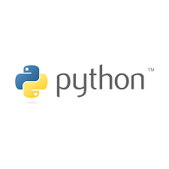



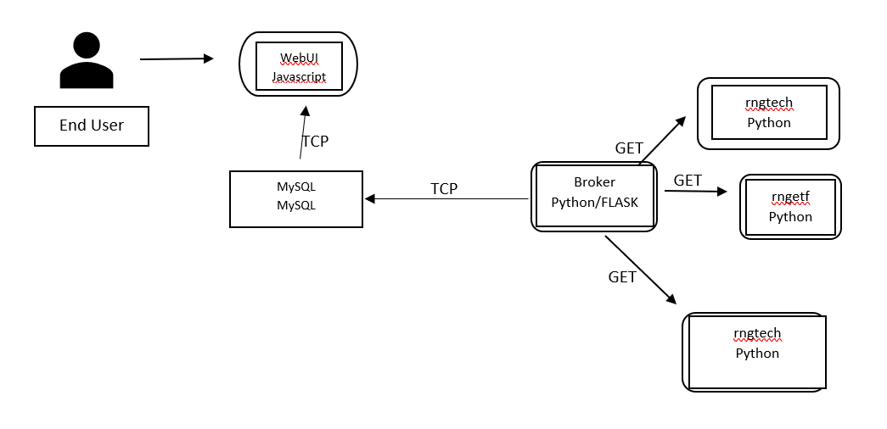

StockWatch
Purpose
Provide a quick and easy to read dashboard for stocks.
Lightweight framework that’s easily managed
Customizable viewing to filter stocks most relevant
Log historical data for analysis purpose
Easily expandable to a larger sample size of stocks
By: Jordan Gumby, Michael Hutz, Corah Krantz, and Mitch Moir
Challenges
No front end experience
Various tools and options
Interface with MySQL vs Redis
Manual Configuration
Data Collection for first iteration
Design:
StockWatch is designed to serve as a constant updating stream of information that is subject to timed modification.
The API is designed to update information held within MySQL, and provide a consistent stream of information to the WebUI.
Sample Layout
Tech
ETF
Crypto
View tabs
Historical Values

